Slide 1


Projects Using Angular 2

Slide 2
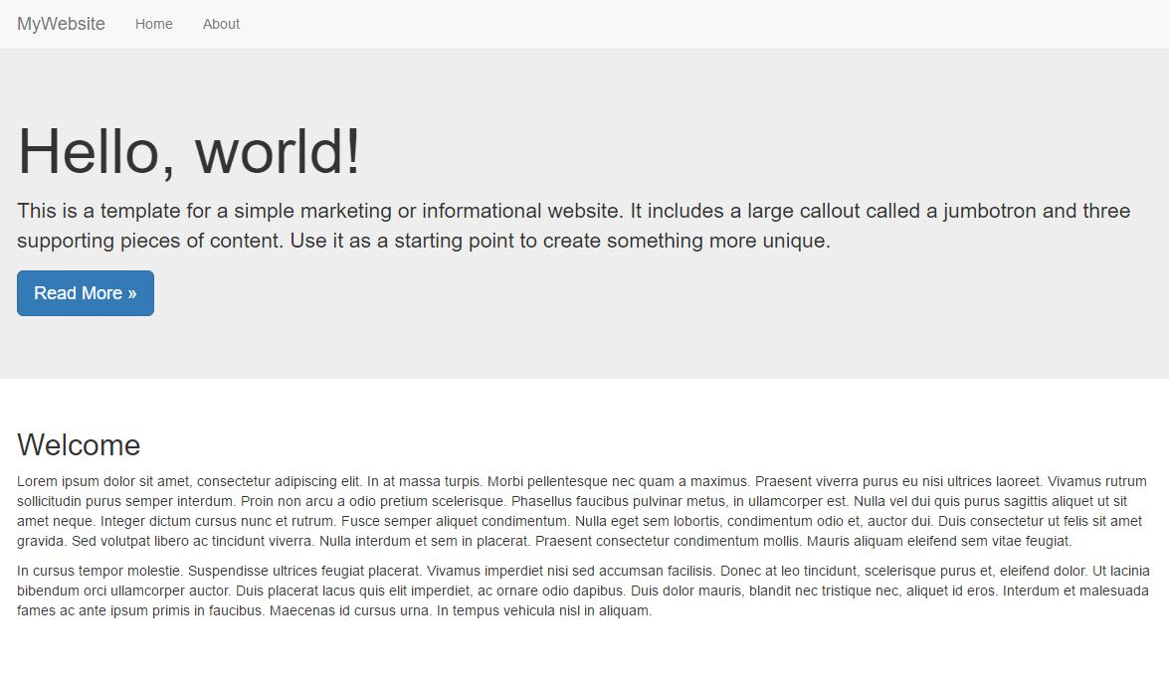
Angular 2 Website
Introductory Project
Setup Angular 2 with Quickstart
Creating Components
Using the Angular 2 Router
Implement Twitter Bootstrap

Slide 3
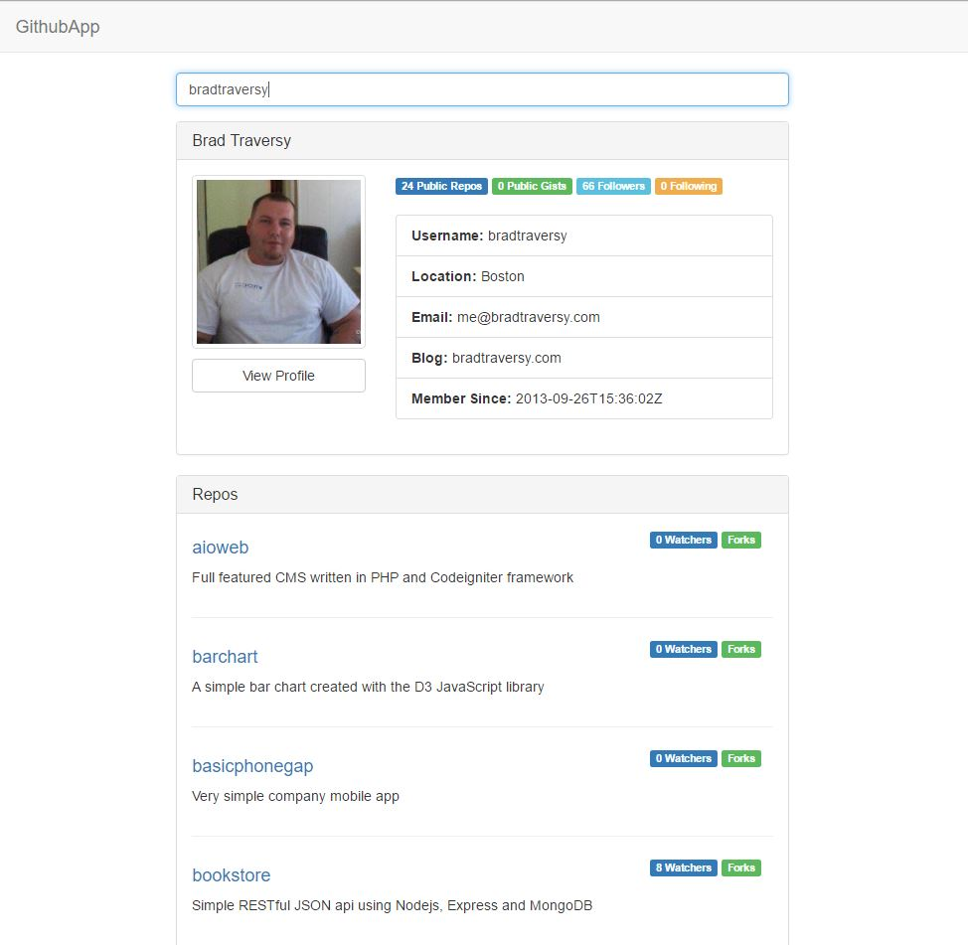
Github Profile Search
Building a Service
HTTP Module to make HTTP GET requests
Observables & Reactive Extensions
ngFor & Iteration

Slide 4
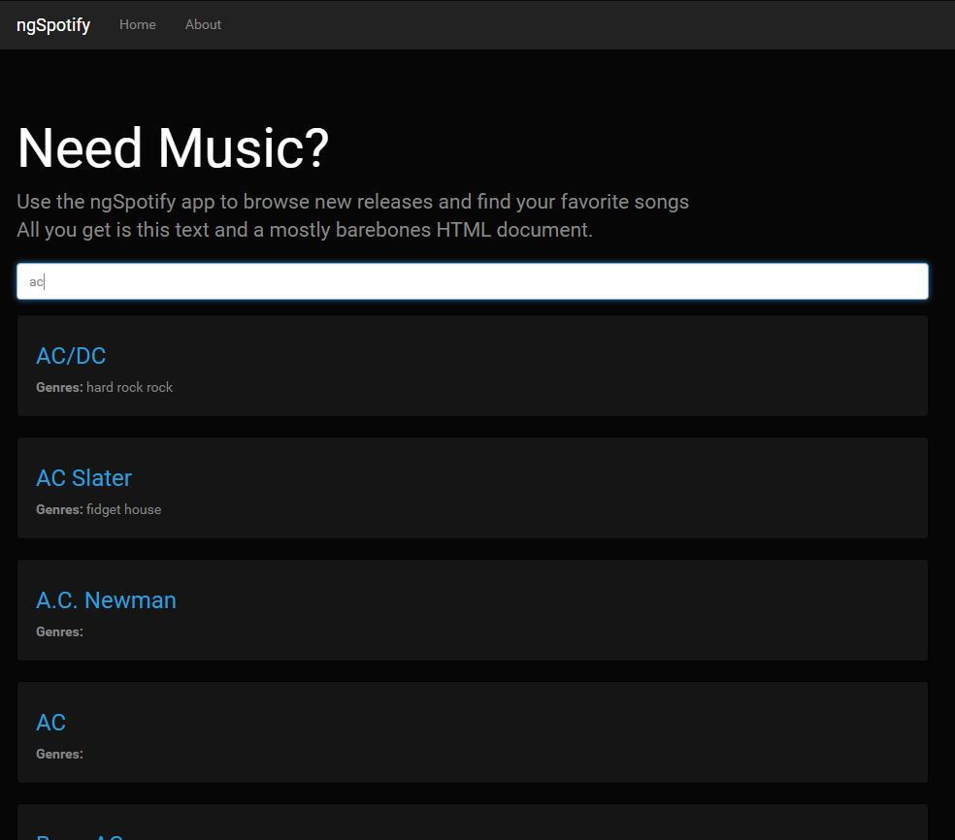
ngSpotify Music App
Routing With Parameters
Forms & Input Events
Spotify Web API
Data Types & Models

Slide 5
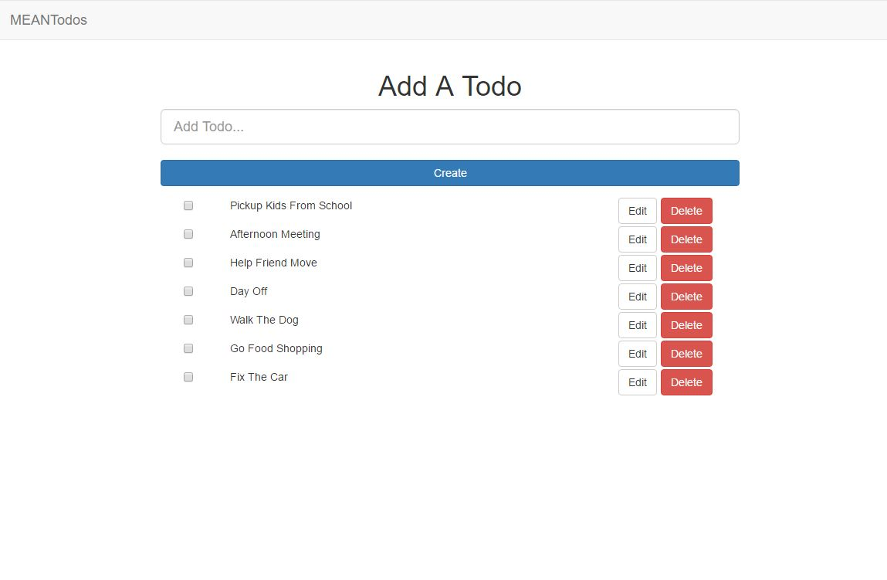
MEAN TODOS App
The MEAN Stack
Node.js / Express Server Setup
MongoJS Backend API
MongoDB & The Console
CRUD Operations

Slide 6
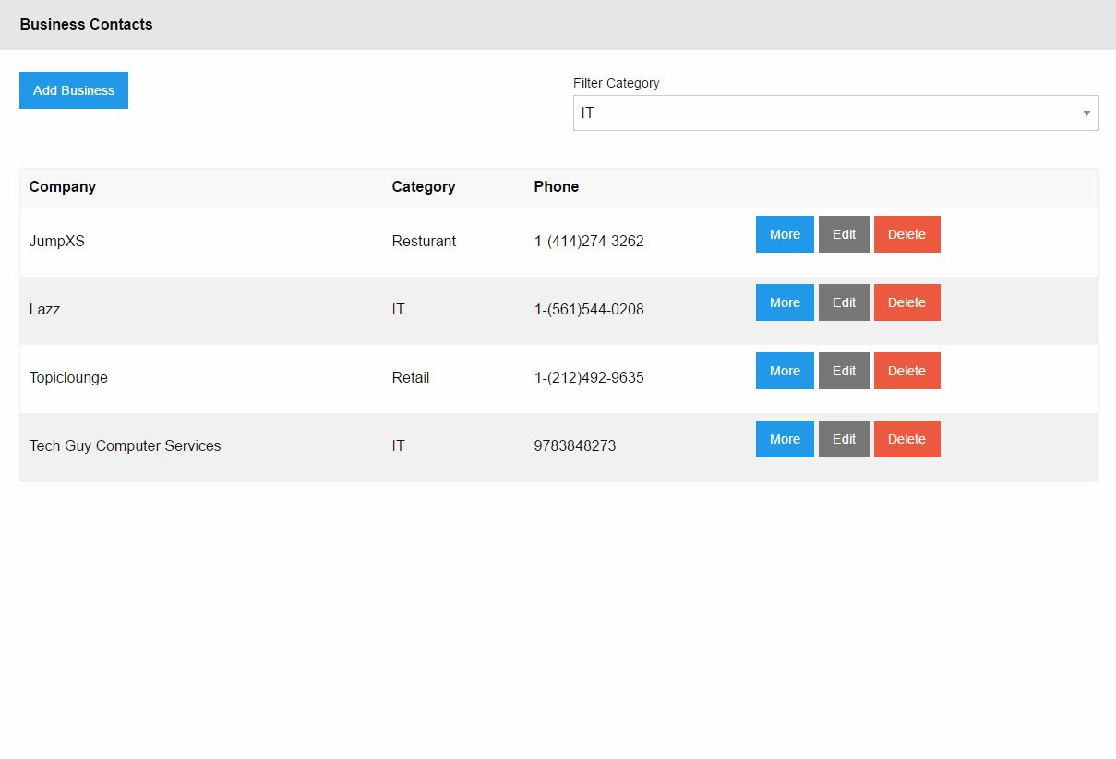
Firebase Business Listings
Angular-cli
Firebase API
AngularFire2
Filtering Data
CRUD Operations in Firebase

Slide 7
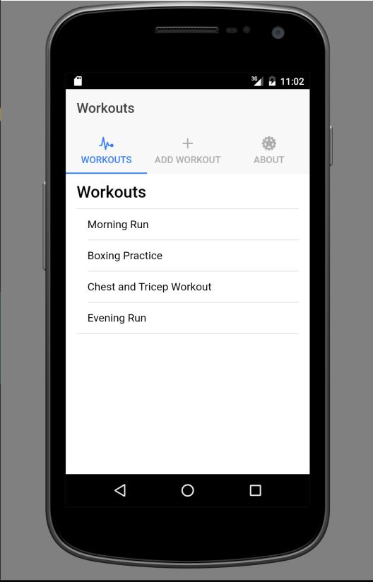
MyWorkouts Mobile App
Ionic 2 Mobile Framework
Android SDK Setup
mLab Database & Data API
CRUD Operations

Slide 8
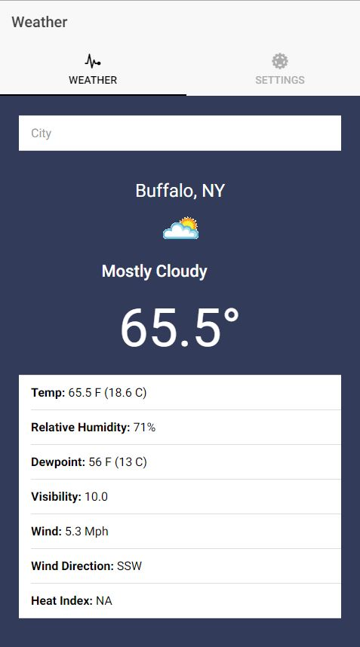
MyWeather Mobile App
Ionic 2 Mobile Framework
Wunderground JSON API
CORS & Proxy Setup
LocalStorage API

Slide 9
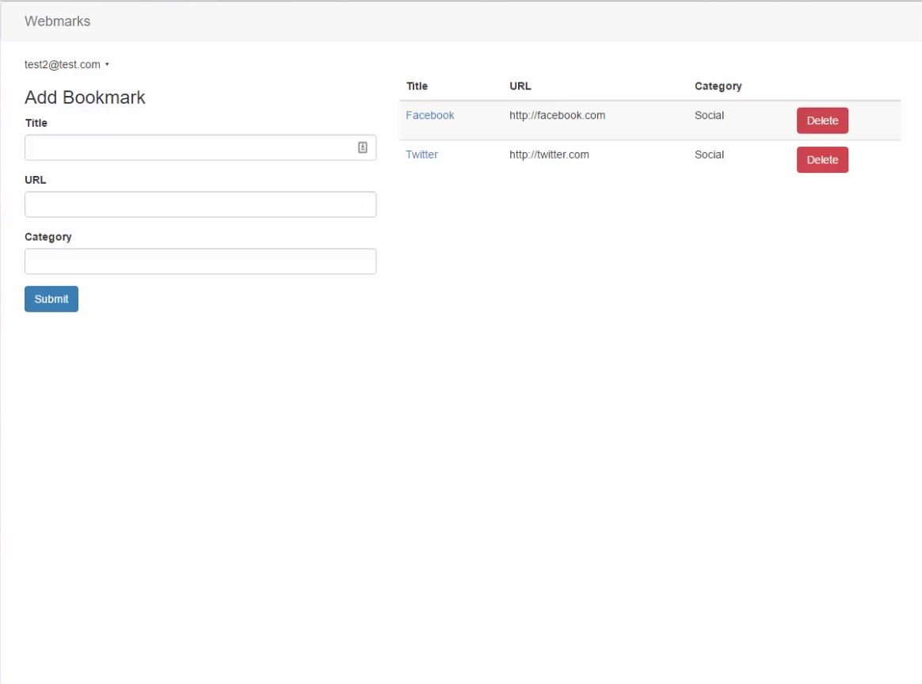
Webmarks
Meteor.js Front & Backend
Meteor-Angular2 Module
Mini-MongoDB & Collections
Meteor Authentication & Access Control

Slide 10
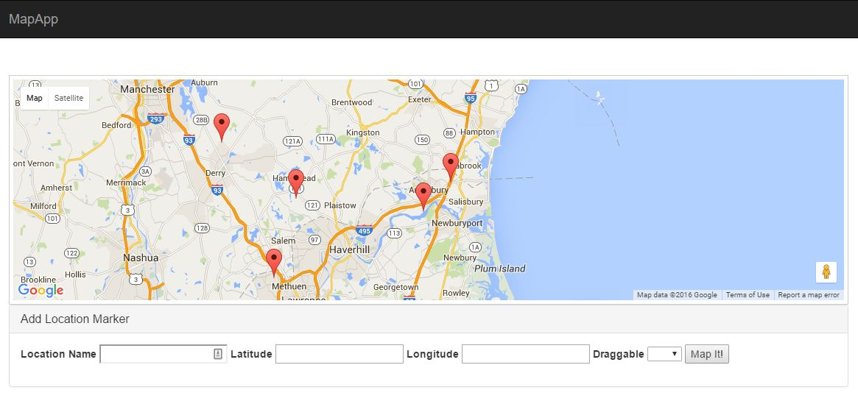
MapIt
Google Maps Module
Display Map Markers
LocalStorage API
CRUD Operations For Markers
FormBuilder

Slide 11
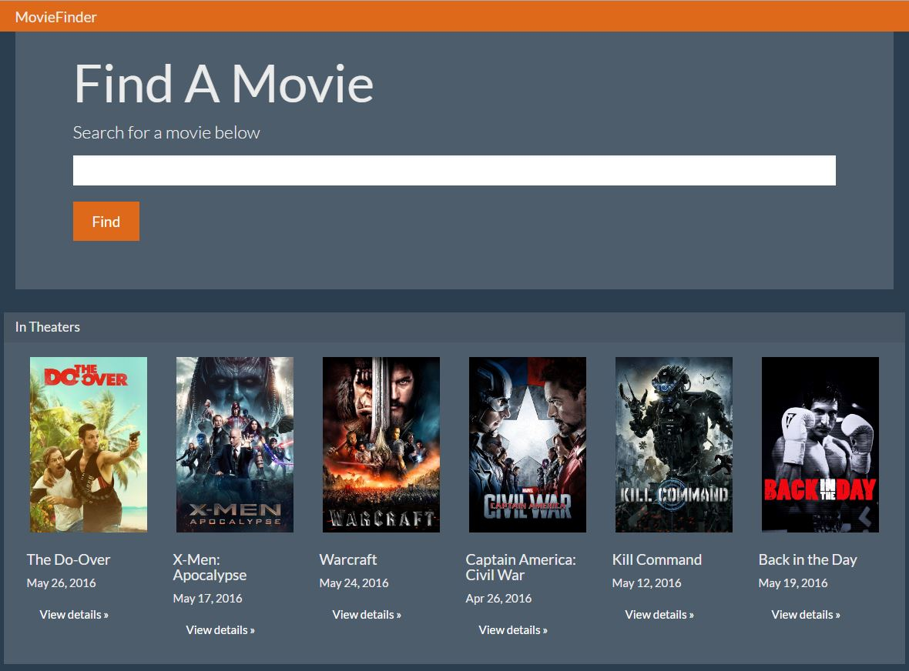
MovieFinder
Themoviedb.org JSON API
Observables and Map Operator
Using RouteParams
Bootswatch UI Theme

